Slide 1
AUTOMATION AND CONNECTED EXPERIENCES ARE BLURRING THE BOUNDARIES BETWEEN PHYSICAL AND DIGITAL

Slide 2
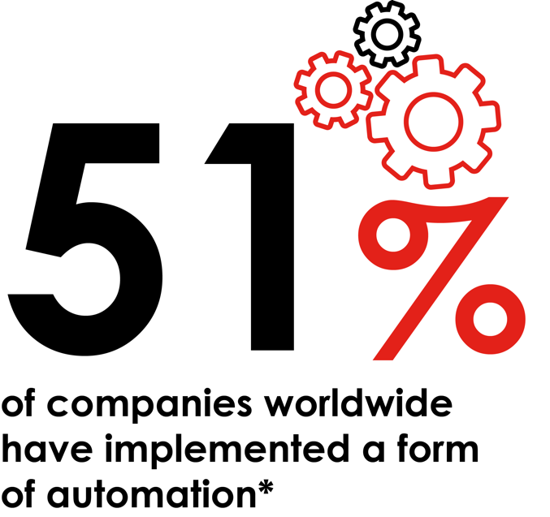
The age of automation
Mail automation can play an important role in marketing & CRM activity
Now you can automate the mailing process in the same way you can with digital – driving measurable results more holistically alongside other channels.
This approach enables you to engage with customers who are unresponsive, whilst driving down costs and booting speed of activation.
Leverage your first-party data to trigger personalized communications in a single view SaaS environment with social, email, SMS & push.

Slide 3
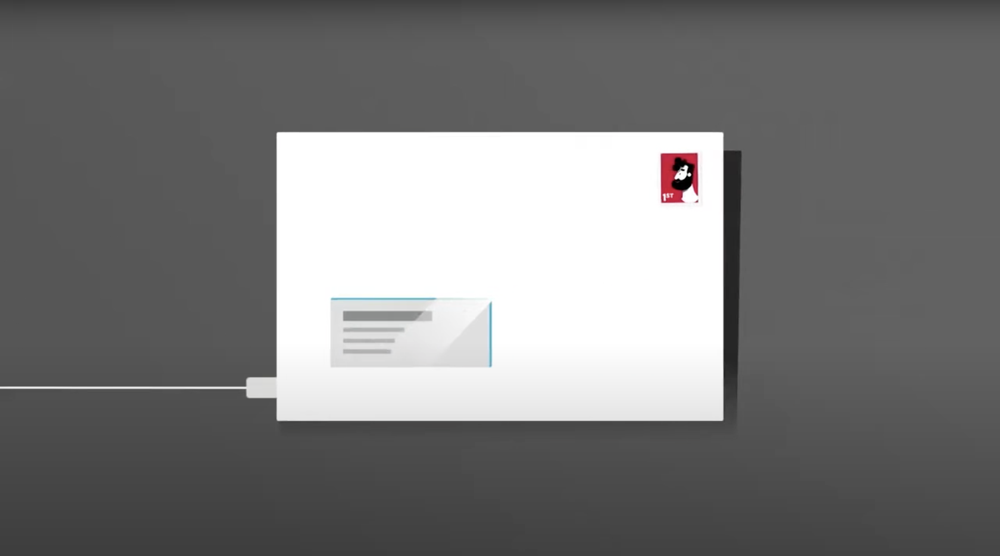
Programmatic mail in action
You can also automate mail into your programmatic plans. Programmatic Mail is a great example of mail and digital integration. It boosts web conversions and improves abandon basket rates.

Slide 6
Qr codes trigger a variety of activations
Letters & Mailers
Statements
Postcards
Door Drops / Leaflets / Flyers
Brochures & Catalogues
Sample Packs & Packaging
Books & Guides
Posters & Banners
Magazines
Tickets
Business Cards
Data Capture
Payments
Audio / MP3
Coupon
Geo-location
Contact / VCard
Web / Product Page
App / App Store
Feedback & Ratings
Social / Advocacy
PDF / Docs
Images
Email
Video
Games
Text / SMS
Call Centre
RSVP
AR

Slide 9
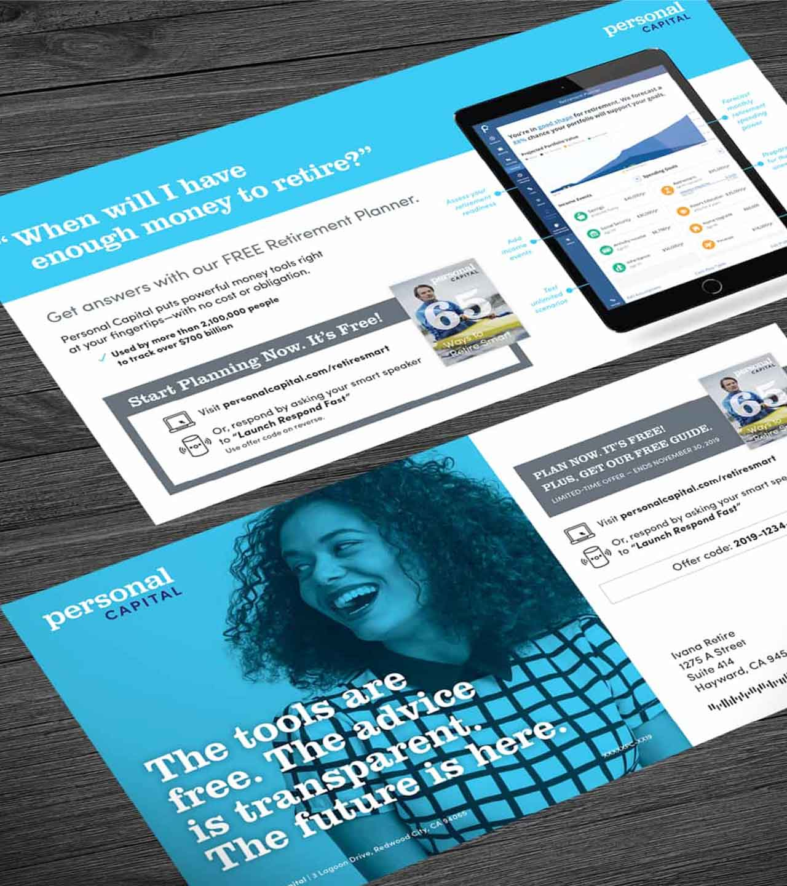
Voice activation & direct mail
With the increase in voice activation, mail is also making it’s mark
Personal Capital, based in San Francisco use voice activation to generate leads for their retirement services.
Activated by a smart speaker, simply tell them your mobile number and they text you further info on how to get your guide to retirement planning.
This directs you to a link.
No attribution problems, easy and seamless for the customer to interact.
Source: Gunderson Direct, USA

Slide 10
Mail and digital integration in practice land rover reinvented direct mail
For the digital generation with the evoque button
BACKGROUND
SOLUTION
RESULTS
Land Rover knew the test drive was a pivotal moment for their new Evoque. They also knew their tech-savvy/time poor audience were bombarded by digital marketing. And with 40% fewer emails post GDPR, how could Evoque reach and engage them?
Direct mail could provide the much needed cut through. The premium mailing allowed them to instantly book a test drive with one press of a button, a glowing replica of the Evoque start / stop engine button. When pressed, it triggered a confirmation email & text message, and was then followed by a phone call from the local dealership to arrange a convenient time.
The luxurious and GDPR-compliant mailing had a 44% response rate, generating over 2,000 test drive requests. Of those, 5% converted –giving Land Rover an ROI of 24:1. The campaign also went viral on social media, all from a budget of just £150,000.

Slide 11
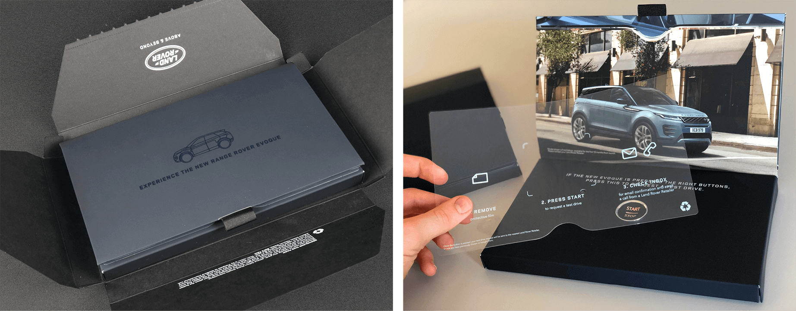

Slide 12
THANK YOU
www.marketreach.co.uk

